Slide 1
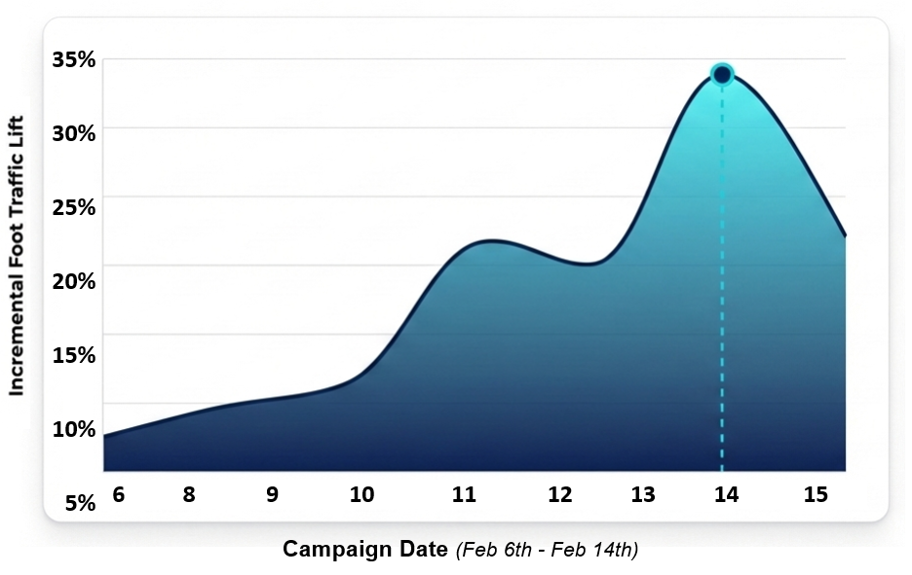
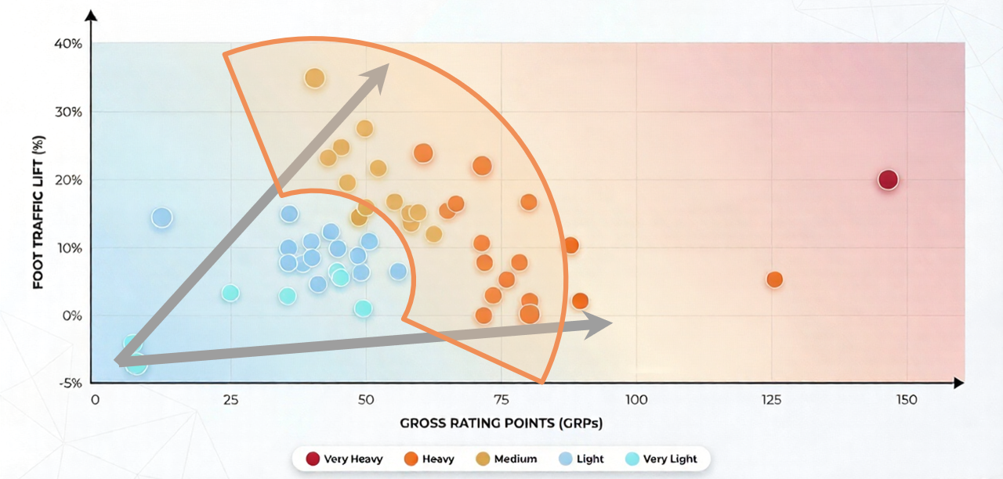
Placer.ai: AM/FM Radio Campaign Drives Significant Increase In Holiday Foot Traffic For A Major Retailer
The Valentine’s Day campaign generated a +34% lift in foot traffic
AM/FM radio resulted in measurable incremental foot traffic increases across the United States footprint
AM/FM radio works: Foot traffic increases as GRP weight grows
Most very light/light markets see 0-10% foot traffic lift; Most medium/heavy markets see 10-30% foot traffic lift
INSERT STATION LOGO HERE
Source: Placer.ai February 2026 Foot Traffic Study

