Slide 1
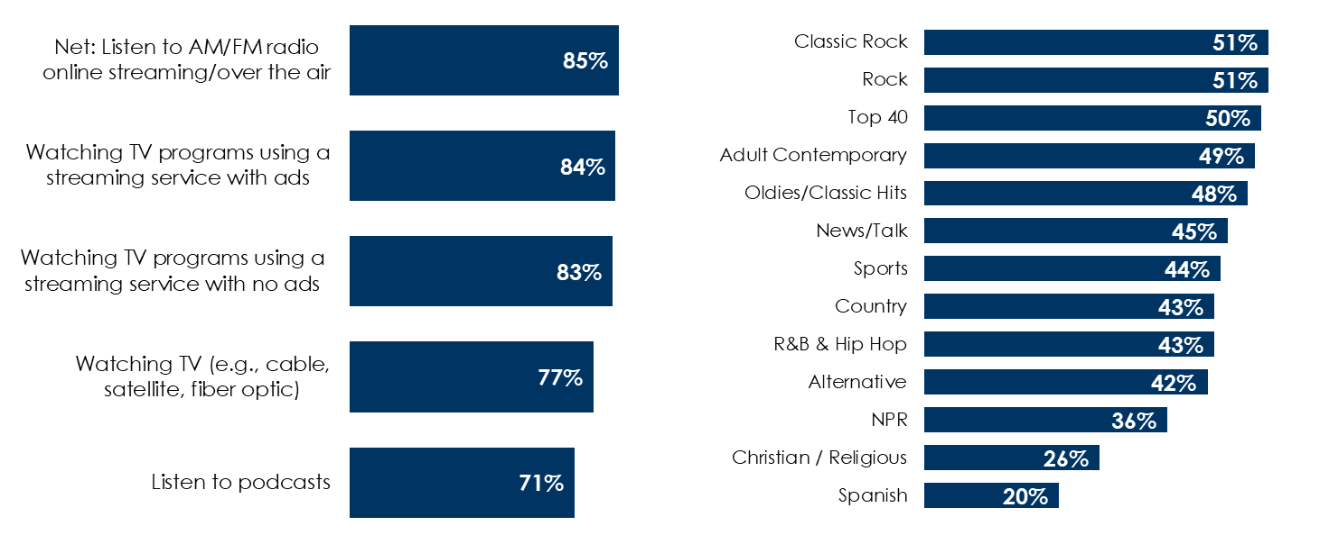
Audio, The Soundtrack Of The American Worker, Is The Ideal Platform For Reaching Hiring Decision Makers
85% of hiring decision makers are AM/FM radio listeners
Hiring decision makers can be reached on a variety of AM/FM radio formats
Q: When is the most recent time, if ever, you spent time doing the following types of activities? % hiring decision makers who answered past month
Q: How frequently do you listen to each of the following AM/FM radio formats? (% of hiring decision makers who listen to the AM/FM radio format “frequently” or “occasionally”, weighted sample = 380)
INSERT STATION LOGO HERE
Source: Left: MARU/Matchbox National Study – December 2024, 1,000 total respondents, 380 hiring decision makers; Q: When is the most recent time, if ever, you spent time doing the following types of activities? Any audio listening: Listen to AM/FM radio via over the air, Listen to AM/FM radio via online (streaming), or Listen to podcasts. Right: MARU/Matchbox National Study – December 2024, 1,000 total respondents, 380 hiring decision makers; Q: How frequently do you listen to each of the following radio formats?

