Slide 1
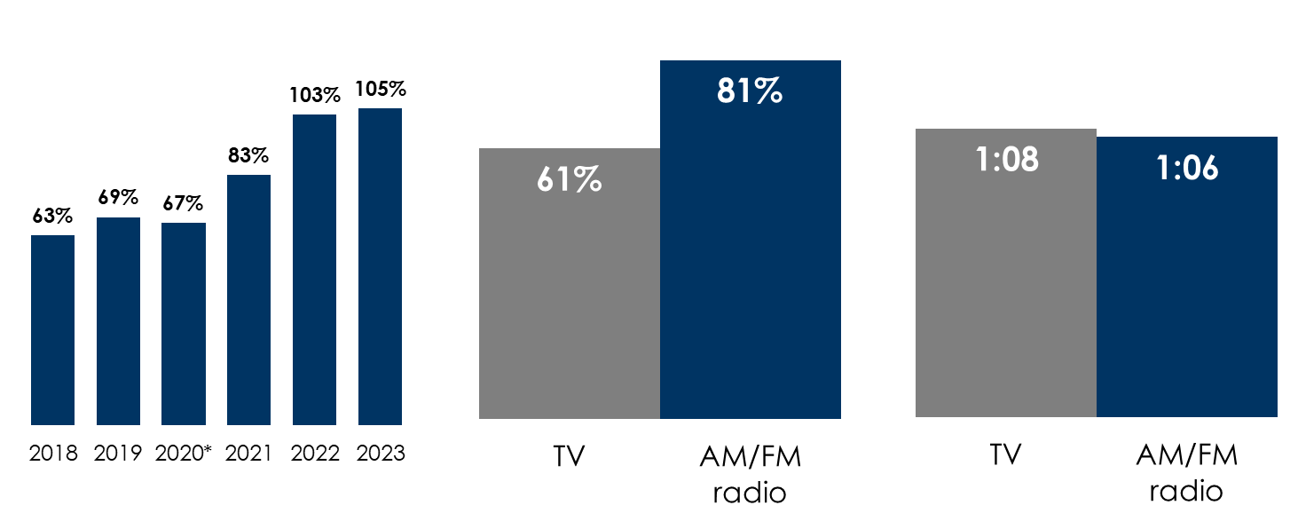
Nielsen Total Audience: AM/FM Radio Ratings Continue To Beat TV Among Persons 18-49
U.S. AM/FM radio's average 18-49 audience has surpassed television: +5% in Q2 2023
Persons 18-49 average audience of
AM/FM radio as a % of live + time-shifted TV
AM/FM radio outreaches TV by +33%
Persons 18-49 weekly reach
% of U.S. population Q2 2023
TV’s daily time spent advantage over AM/FM radio is shrinking
Persons 18-49 daily time spent
Hours:minutes among U.S. population
Q2 2023
Source: Left: Nielsen Total Audience Report, Q2 2018, Q2 2019, Q2 2020, Q3 2021, Q3 2022, Q2 2023. Persons 18-49. Average audience determined by multiplying weekly reach of users by weekly time spent among users of each medium; Middle & Right: Nielsen Total Audience Report, Persons 18-49 weekly reach % of users of live + time-shifted TV among U.S. population. Daily time spent is hours:minutes among U.S. population. Right: Edison Research, "Share of Ear,” Q3 2022-Q2 2023. Persons 18+; SiriusXM: Ad-Supported: Spoken Word. Ad-Free: Music; Podcasts listened to on streaming platforms are included in 'podcasts.'
INSERT STATION LOGO HERE

